Slide 1

THAT’S NOT MY RJ45 JACK!
IRL NETWORKING FOR HUMANS, Pt. 1
J0hnny Xmas | @j0hnnyXm4s

Slide 2
Why Are We Here?
Not just learning to be a sycophant; we’re not trying to collect a bunch of Pokemon to ignore until we need them
Networking is an organic process. We are organisms.
Being a SOURCE for talent recommendations also makes you useful / cool / desirable as a friend
Notes:
This is not just about getting a job or promotion; It’s about making your current job easier by bettering your relationship with coworkers, especially on other teams. Its is all about making people like you.

Slide 3
Ye Olde Disclaimer
I acknowledge that even I am not great at some of the topics I will cover here.
You will need to find what works for you, and identify / fix what doesn’t.
Life decisions you’ve already made may interfere with your ability to execute on some of this.
Society is woven around inconvenient truths. This will make you angry. Your anger does not change these truths.

Slide 4
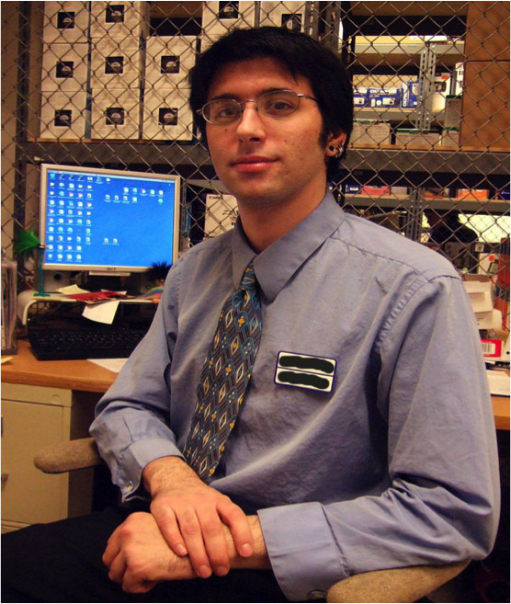
Street Cred!
Notes:
Agoraphobic
Adult acne
Greasy hair
Severe scoliosis
Clothes don’t fit me

Slide 5
Street Cred!
Got my first for-realz IT job through a friend I made while working retail
Landed a base InfoSec engineer role with a GLOBAL 1000 co. via a friend I made while playing board games
Promoted to Senior within 18 months
Promising career Red Teaming as a Sr. Consultant via a friend I’ve only seen 5 times

Slide 6

Semi-Charmed Life?

Slide 7

NO!

Slide 8

Magick?

Slide 9
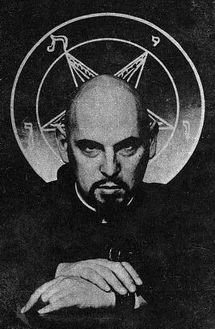
Maybe a little!

Slide 10
I LEARNED
TO PLAY
THE GAME.

Slide 11

REQUIRED READING

Slide 12
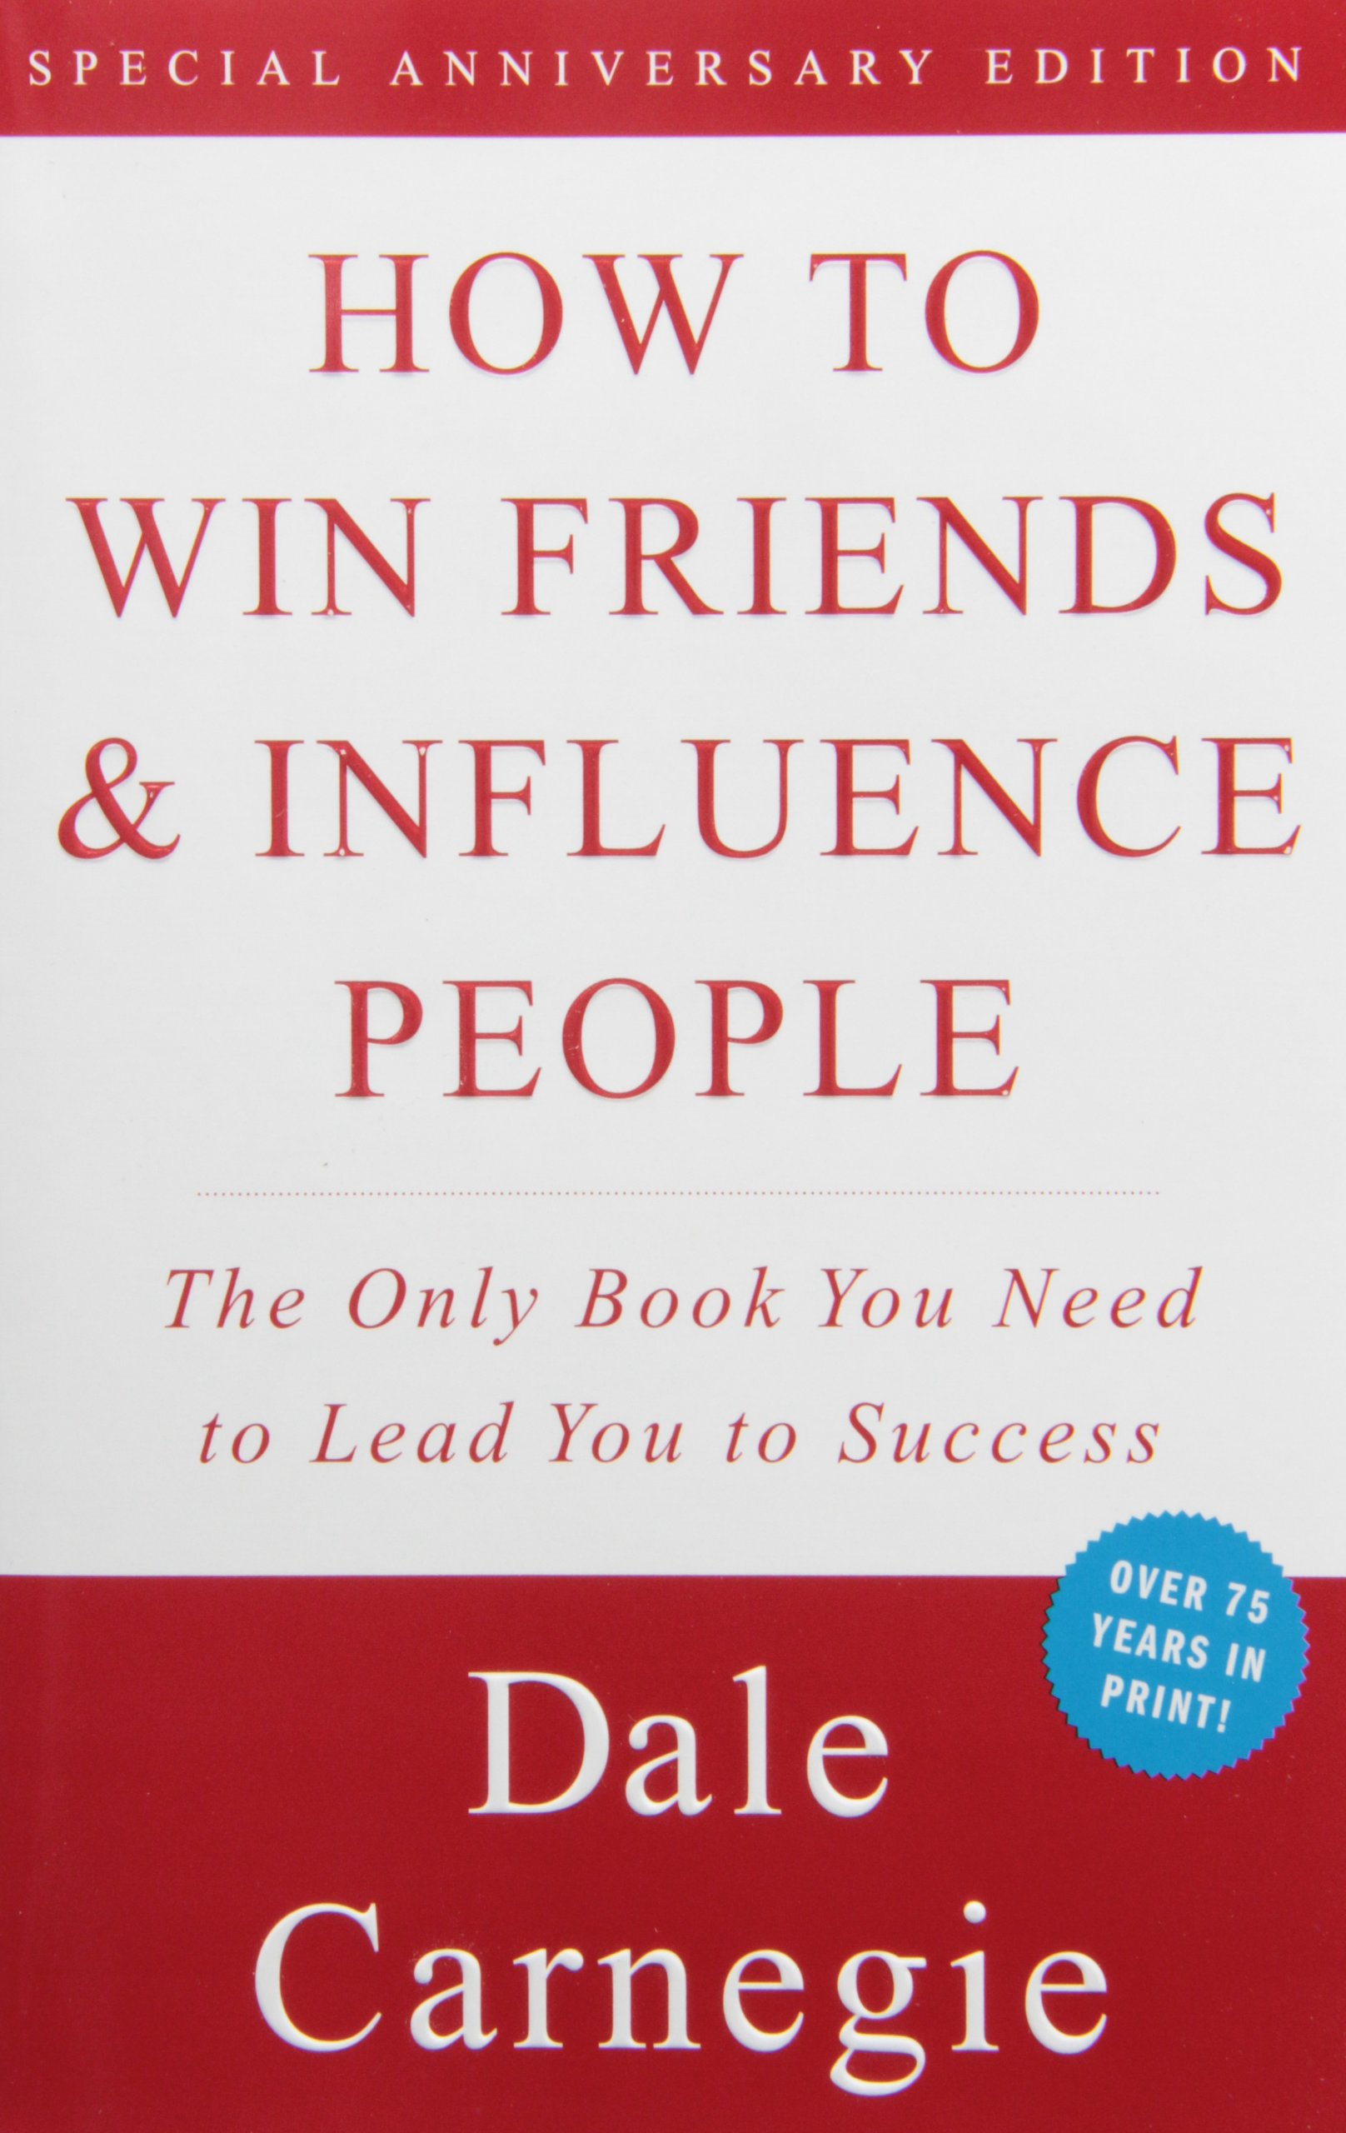
REQUIRED READING

Slide 13

REQUIRED READING

Slide 14

REQUIRED READING

Slide 15
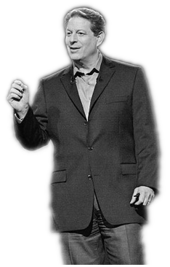
INCONVENIENT TRUTH #1:
The Game is Real Whether You
Like It or Not.

Slide 16
INCONVENIENT TRUTH #1:
The Game is Real
Your only choice is whether to play, or sit back and watch people play it.
‘The WORST pro sports players make more than any of us who sit at home and watch them.
Even a participation trophy is better than the nothing you get for not playing.
“Showing up is 80% of life” – W. Allen

Slide 17
THIS IS HOW YOU GET
THAT PARTICIPATION TROHPY
THIS IS HOW YOU SHOW UP
Notes:
COFFEE IS FOR CLOSERS
Showing up means a lot of things. In the literal, it means just going to where you should be going, instead of staying home in bed. You’re not going to meet that person who’s going to be useful to you by sitting on the couch. Random strangers don’t happen to pass by your bed. At least, not the useful ones.

Slide 18
INCONVENIENT TRUTH #2:
“Showing Up”
is Actually
Really Hard

Slide 19
INCONVENIENT TRUTH #2
Showing up is hard.
“It is so much easier not to do things than to do them, that you would do anything at all is totally remarkable.
In terms of instant relief, cancelling plans is like heroin.
If you ever ask an adult what they did over the weekend, and they say they didn’t do anything, Their faces LIGHT UP.”
John Mullaney
Notes:
Rant about playing the game or sitting and watching it be played. Worst players still make more than any of us. Participation trophies better than nothing.

Slide 20
How to Show Up:
DO IT.
GO.
Srsly.
SAY YES TO EVERYTHING.

Slide 21
OMG MATH IS REAL
The more places you show up to, the greater your chances of being in the right place at the right time. Period.

Slide 22
This Sounds like Work
IT IS.
It’s a skill, and like all skills, you must practice in order to master it
You’re not going to click with everyone.
A 20% (1 in 5) success rate is considered masterful.
Regardless of this, DO NOT BURN BRIDGES.
EVER.

Slide 23
Great. I’m here. Now what?
WORK THE ROOM:
Put your phone / laptop / Google Glass / away
Stand up / Walk around
Open your eyes, have a positive demeanor
Find your Happy Place
Find the largest group of people, and integrate
Fill in a conversational lull with a personal experience
People love stories about failure
Match the energy of the group

Slide 24
THE JOHNNY XMAS GRAND UNIFIED CREEPINESS THEORY
(using the standard 1-10 scale for all values)

Slide 25
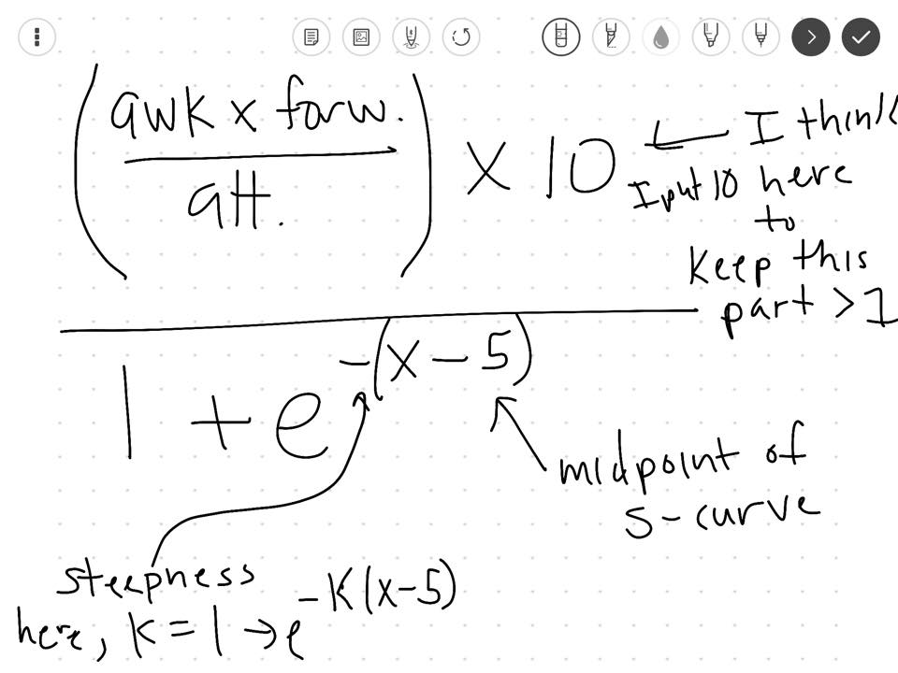

Slide 26
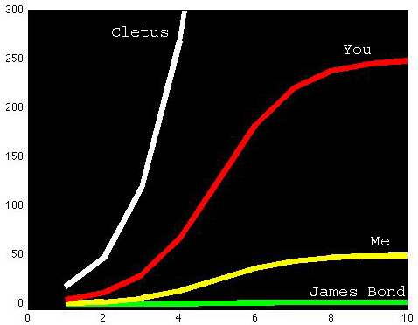

Slide 27
What am I doing wrong?
Wallflowering
Creeping on people \ conversations
Being constantly negative
Talking shop \ About work
This is OK if someone else initiates it, and you know what you’re talking about
Also share positive work stuff

Slide 28
INCONVENIENT TRUTH #3:
Nobody Wants to Listen to You

Slide 29
INCONVENIENT TRUTH #3
The more someone talks to (not with) you, the more they will like you
So, MAKE them talk to you:
Ask probing questions
“Active Listening” (“Really? That’s Cool.”)
Don’t offer unsolicited advice; only sympathy.
Also, practice your empathy. Find your “zone.”

Slide 30
INCONVENIENT TRUTH #3
Do you talk too much? Look for these signs:
Minimal eye contact
Only responding with “Uh-huh. Yeah. Mmm-hmm.”
Not asking questions
Chicken Heading
Checking their phone
Talked to the same person for more than 15 minutes.
You’re drunk.

Slide 31


Slide 32
Help Me Not Suck!
Take improv classes
Try open mic standup comedy
Learn & perform street magic
Work other rooms besides tech meetups
Shared experiences:
Nightclubs \ Dance clubs
Bookstores
Art galleries \ Museums
Long lines

Slide 33
End of Act 1
Johnny Xmas | @j0hnnyXm4s | https://github.com/johnnyxmas

